Slide 1

Application of group theory in Artificial Intelligence
By : Yousef Abu ALI
Id:21110294
Discrete Math's class No:3

Slide 2
Table of content:
Group theory
Group
Applications of group theory
Artificial Intelligence
Application of group theory in AI

Slide 3
Group Theory
Group theory is considered an important concept in algebra. it studies sets and a binary operation that could be applied into two elements of these sets.
It illustrates how these operations use certain rules in order to understand certain concepts such as symmetry, patterns, as well as structures in many fields.
It helps in the understanding of certain concepts such as symmetry, patterns, as well as structures in math, science, and art.
Notes:
the major goal of group theory is to examine the characteristics,
relationships as well as patterns of the groups by using a set of
theorems. In addition, group theory generates some insights into verity of mathematical contexts
as well as real world applications.
the rules demand that the operation must be Associative, have an identity element as well as have an inverse for each element.

Slide 4
Group
In the context of group theory, a group is considered as a collection (set) who has members which are known as elements such as numbers.
A binary operation is used to combine any two elements of a set which results in having an element from the same set. (the result should be an element from the original set).
The binary operation should satisfy four essential characteristics (Property): Closure, Associativity, Identity, and Inverse.
Notes:
The element that results from the binary operation between a and b, must be from the same set that a and b came from.

Slide 5
Group
Closure: It requires to check that for any two elements such as ‘a’ and ‘b’ in a group, when an operation is applied on them, the result must be from the same group that ‘a’ and ‘b’ came from.
Associativity: it requires to check that when an operation is performed on any three elements, the order of that operation would not matter. For example, (a*b)*c is the same as a*(b*c).
Identity element: an identity element is a special member of group, which is written as e. when an operation uses any element with the identity element
Inverse element: an element of a group has an element from the same group known as it’s inverse. When we perform an operation on them, we will have the identity element as a result.
Notes:
The element that results from the binary operation between a and b, must be from the same set that a and b came from.
For all the elements in G such as ( a, b), the result of any operation between two elements of G will be in G. a ∈ G, b ∈ G → a *b ∈ G
For any three elements in G the order of operation on them will not affect the result. (a*b)*c = a*(b*c)
3. The identity element says that there exist an element e in S, where for all the elements a in s the equation e*a=a*e=a will remain the same.
4. For every element a in S there is an element b in S where a*b = b*a = e. And e is the identity element.

Slide 6
Some applications of group theory
Physics: Group theory is used in understanding the laws of physical systems. It is used physics in fields such as quantum mechanics, particles, and matter physics.
Symmetry in Art: Group theory is an important part in art when analyzing and creating good designs in both architecture and art.
Cryptography: Group theory is applied in some of the encryption methods and protocols, for example the Diffie-Hellman key exchange, as it uses a discrete logarithm problem.

Slide 7

Some applications of group theory
Robotics: Group theory is applied to show and analyze the movement and transformation of robots, which helps when planning for robotic motion and controlling.
Artificial intelligence: Group theory is employed to recognize the symmetries and patterns in a certain data. which improve some AI tasks such as image recognition as well as feature extraction.

Slide 8

Application of group theory in Artificial Intelligence

Slide 9
Artificial Intelligence
Artificial intelligence is the science of making machines more intelligent.
AI focuses on designing computers in a way that enables them to learn, improve, and think like people.
AI makes computers able to perform task that normally requires human intelligent to solve.
For example: Understanding different languages, recognizing certain patterns, as well ad making decisions.
Notes:
The main goal of Artificial Intelligence is to create machines or systems that are able to mimic the human brain and intelligence.
It gives the machines the ability to perform certain tasks automatically, gain information from data and learn from it, solve difficult problems, predict the future ( Trends), help humans.
All in all, AI aims to improve the accuracy, efficiency, and save people’s time in multiple domains.

Slide 10
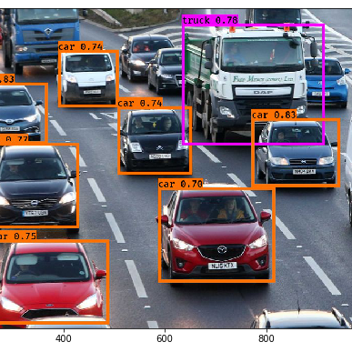
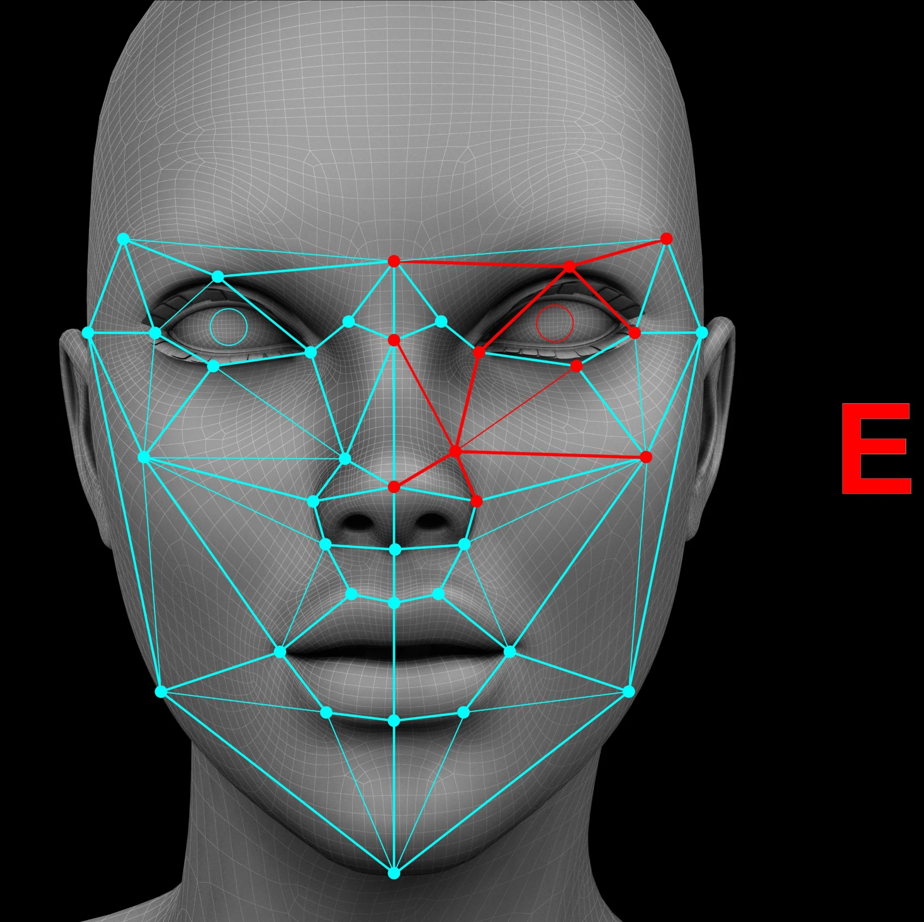
Application of group theory in Artificial Intelligence
Discovering Symmetry:
Group theory is used in AI In order to find symmetries in data, and this can greatly enhance accuracy and efficiency in certain tasks, such as object detection and image recognition.

Slide 11

Application of group theory in Artificial Intelligence
Feature extraction: The concepts of group theory are being used to create more reliable, strong, and clear feature extraction approaches. These approaches aid in finding important information from the raw data, most certainly in situations where we have close or connected patterns.

Slide 12

Application of group theory in Artificial Intelligence
Data Augmentation:
The techniques of data augmentation are most often used to increase the amount of training data artificially, which helps in improving the machine learning model’s ability to work better.
The benefit of group theory here is its ability to guide how the augmentation operations are selected by keeping in mind the symmetries available in the data.

Slide 13
References:
group theory | Definition, Axioms, & Applications | Britannica. (2019). In: Encyclopædia Britannica. [online] Available at: https://www.britannica.com/science/group-theory.
Wellens, J. (n.d.). A FRIENDLY INTRODUCTION TO GROUP THEORY. [online] Available at: https://math.mit.edu/~jwellens/Group%20Theory%20Forum.pdf.
VEDANTU. (n.d.). Group Theory in Mathematics. [online] Available at: https://www.vedantu.com/maths/group-theory-in-mathematics.
Brilliant.org. (2016). Group Theory | Brilliant Math & Science Wiki. [online] Available at: https://brilliant.org/wiki/group-theory-introduction/.
Wikipedia. (2023). Group theory. [online] Available at: https://simple.wikipedia.org/wiki/Group_theory

Slide 14
Thank you

